Slide 1
Chapter 5.2 Code Tuning Strategies and Techniques
CCSW 325 (Software Construction)
Notes:
Last Update: 22/8/2019
Version 1.0

Slide 2
Outline
Expressions
Data Transformations

Slide 3

Expressions
Much of the work in a program is done inside mathematical or logical expressions.
Complicated expressions tend to be expensive, so this section looks at ways to make them cheaper.

Slide 4
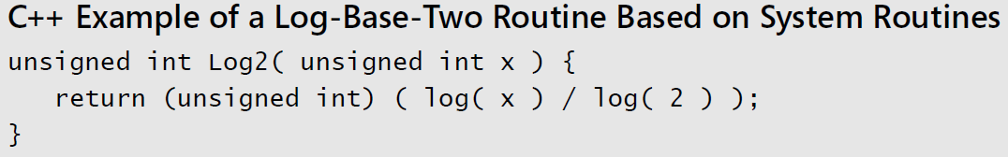
Expressions
Initialize at Compile Time
If you’re using a named constant or a magic number in a routine call and it’s the only argument, that’s a clue that you could precompute the number, put it into a constant, and avoid the routine call.
For example, compute the base-two logarithm of an integer, truncated to the nearest integer. If the system doesn’t have a log- base-two routine, a quick and easy approach:
Notes:
Here we are computing log2 each time we call this method.

Slide 5
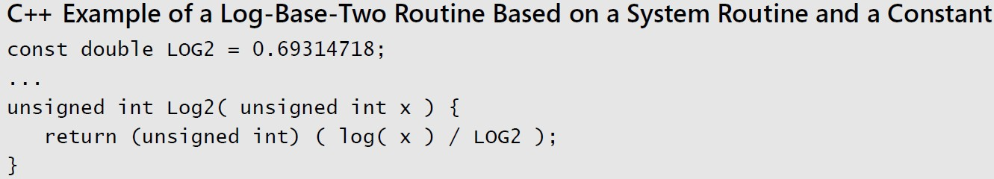
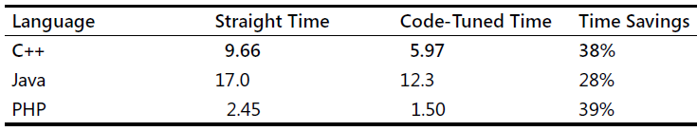
Expressions
Because the value of log(2) never changed, replace log(2) with its computed value, 0.69314718, like this:

Slide 6
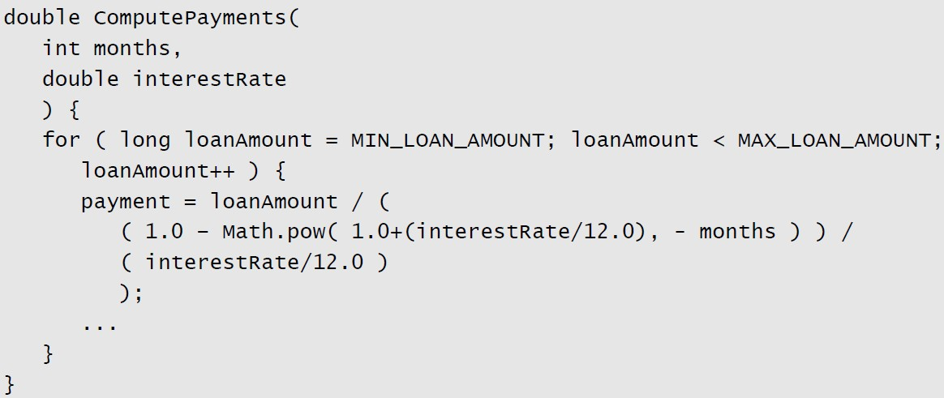
Expressions
Precompute Results
If the results are used many times, it’s often cheaper to compute them once and look them up the rest of the time.

Slide 7
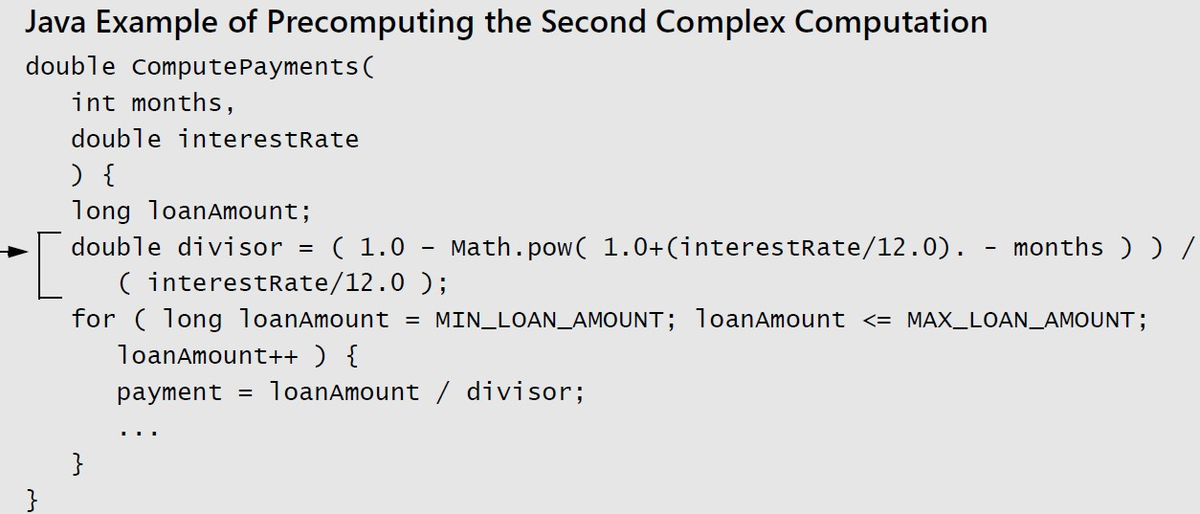
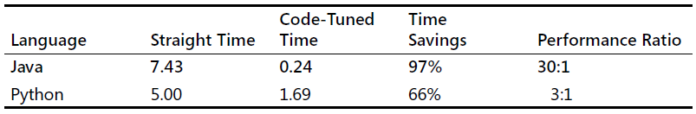
Expressions

Slide 8
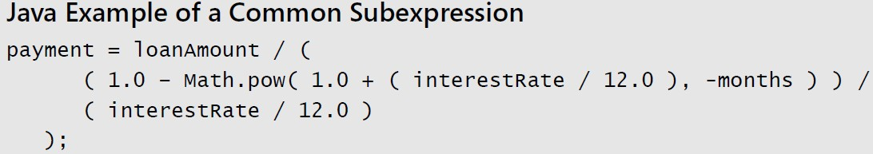
Expressions
Eliminate Common Subexpressions
If you find an expression that’s repeated several times, assign it to a variable and refer to the variable rather than recomputing the expression in several places.
The loan-calculation example has a common subexpression that you could eliminate. This is the original code:

Slide 9

Expressions
Exploit Algebraic Identities
You can use algebraic identities to replace costly operations with cheaper ones.
For example, the following expressions are logically equivalent:
If you choose the second expression instead of the first, you can save a not operation.

Slide 10
Expressions
Use Strength Reduction
Strength reduction means replacing an expensive operation with a cheaper one. Here are some possible substitutions:
Replace multiplication with addition.
Replace exponentiation with multiplication.
Replace floating-point numbers with fixed-point numbers or integers.
Replace double-precision floating points with single-precision numbers.
Replace integer multiplication-by-two and division-by-two with shift operations.
Notes:
XDR defines the single-precision floating-point data type as a float.
The XDR standard defines the encoding for the double-precision floating-point data type as a double.
A variable of type float only has 7 digits of precision whereas a variable of type double has 15 digits of precision Each shift to the left doubles the number, therefore each left shift multiplies the original number by 2.
// multiply a by 2
n = n << 1;
// divide b by 2
m = m >> 1;

Slide 11
Data Transformations
Changes in data types can be a powerful aid in reducing program size and improving execution speed.
Here are a few ways to tune your data types.

Slide 12
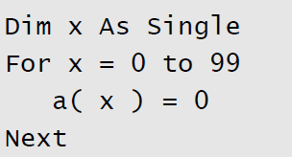
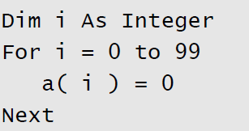
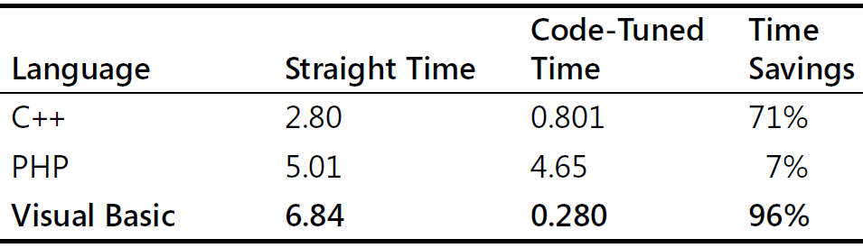
Data Transformations
Integers over Floats
Integer addition and multiplication tend to be faster than floating point.
Changing a loop index from a floating point to an integer, for example, can save time:

Slide 13
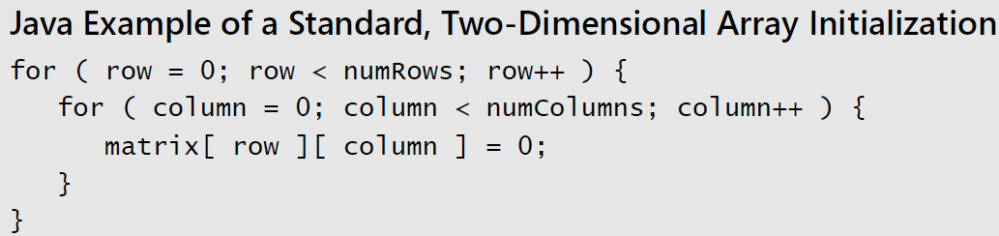
Data Transformations
Fewer Array Dims
Multiple dimensions on arrays are expensive.
If you can structure your data so that it’s in a one-dimensional array rather than a two-dimensional or three-dimensional array, you might be able to save some time.
Suppose you have initialization code like this:

Slide 14
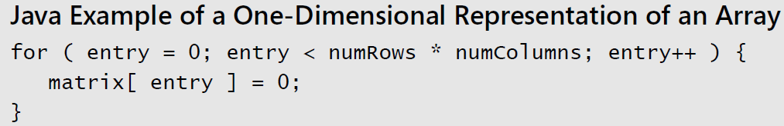
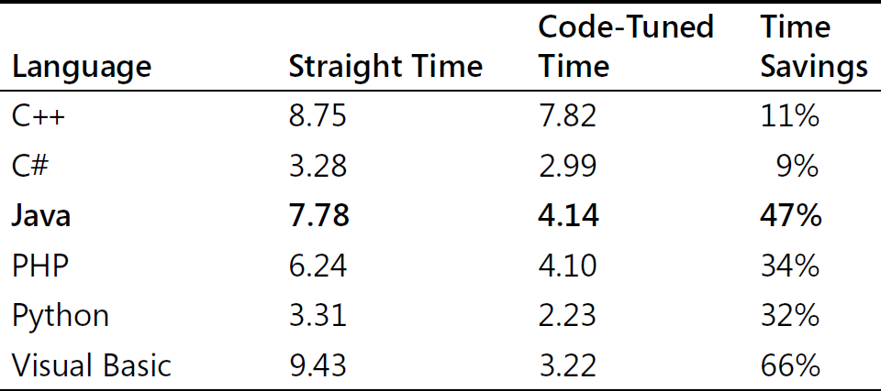
Data Transformations
When this code is run with 50 rows and 20 columns, it takes twice as long with a Java compiler as when the array is restructured so that it’s one-dimensional.

Slide 15
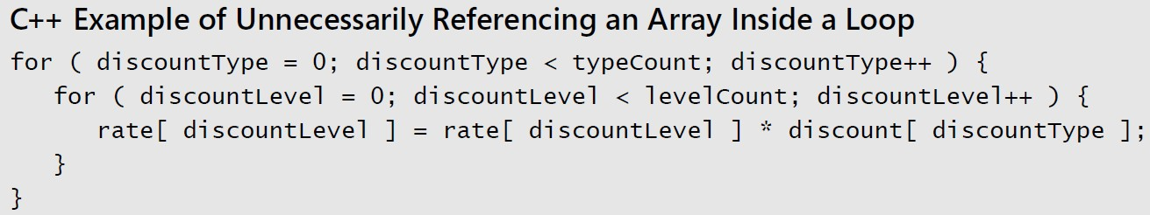
Data Transformations
Less Array References
In addition to minimizing accesses to doubly or triply dimensioned arrays, it’s often advantageous to minimize array accesses.
A loop that repeatedly uses one element of an array is a good candidate for the application of this technique.

Slide 16
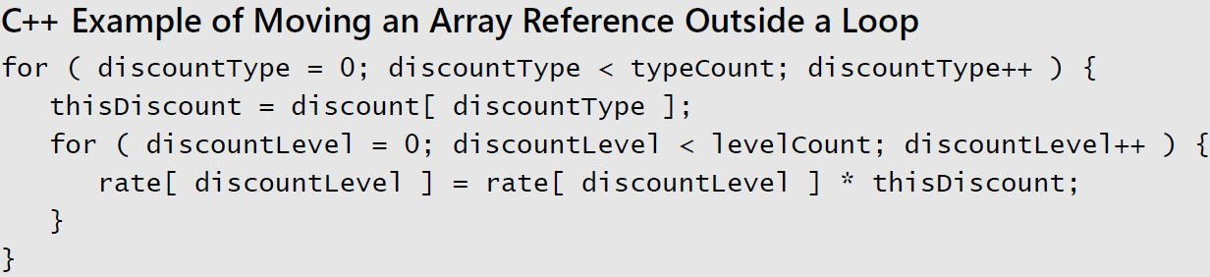
Data Transformations
The reference to discount[ discountType ] doesn’t change when discountLevel changes in the inner loop.
Consequently, you can move it out of the inner loop so that you’ll have only one array access per execution of the outer loop rather than one for each execution of the inner loop.

Slide 17
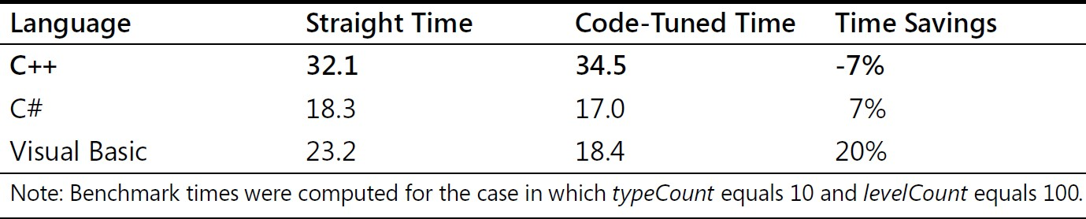
Data Transformations
Results vary significantly from compiler to compiler.

Slide 18
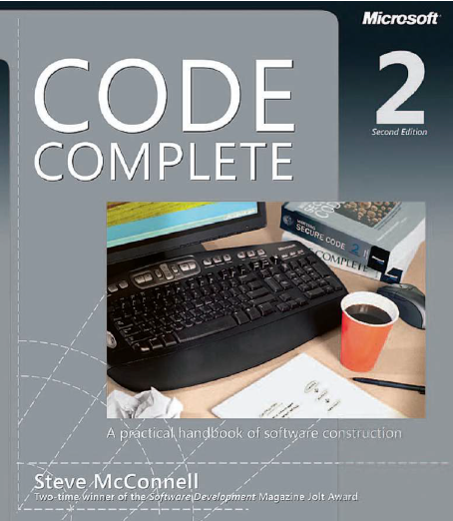
Reading
Code Complete: A Practical Handbook of Software Construction, 2nd Edition, Steve McConnell.
Chapter 26

Slide 19

Any questions? ​
Please feel free to raise your hands and ask.

